Slide 1
LEAD SCORING CASE STUDY
SUBMITTED BY
Neelanjan Roy | Akshay Roy | Sameer Kumar

Slide 2
Business Objective:
❖To Help X Education Select Most Promising Leads (Hot Leads), i.e. The Leads That Are Most Likely To Convert Into Paying Customers.
❖ Selection of hot leads
❖ Focused marketing
❖ Higher lead conversion rate

Slide 3
GOALS OF THE CASE STUDY:
To build a Logistic Regression model that assigns lead scores value between 0 and 100 to each of the leads which can be used by the company to target potential leads such that the customers with higher lead score usually have a higher conversion chance and vice versa.
❖ Create a Logistic Regression model to predict the Lead Conversion probabilities for each lead.
❖ Decide on a Probability Threshold value above which a lead will be predicted as converted, whereas not converted if it is below it.
❖ Multiply the Lead Conversion probability to arrive at the Lead Score value for each lead.

Slide 4
APPROACH :
Reading & understanding the data
❖ Data cleaning
❖ EDA
❖ Feature scaling
❖ Splitting the data into test & train dataset
❖ Prepare the data for modelling
❖ Model building
❖ Model evaluation-specificity & Sensitivity or precision recall
❖ Making predictions on the test
❖ Assigning lead score
❖ Hot leads Determination
❖ Feature Importance Determination

Slide 5
Data Cleaning:
There were few columns which were having a high number of null values which are dropped straight away. Further, we can not eliminate all columns which might be useful and were having a great impact on our model but are having a strong possibility of high number of null values so we can treat those columns by imputing with mean and median by observing the type of the variables i.e. (continuous or categorical). The outliers which were found during the analysis has also been removed. After those process up to 98% data has been retained and on this cleaned data the analysis was performed

Slide 6
Exploratory Data Analysis (EDA) :
EDA was performed on the cleaned data by plotting different types of plots and analysing both the variables which is continuous and categorical. Univariate analysis was done against the target variable for better understanding. It looks at the range of values, as well as the central tendency of the values. It describes the pattern of response to the variable and it also describes each variable on its own.
Some of the insights are as follows: People spending more time are promising Leads, The Lead Origin- Landing Page Submission has the highest conversion rate among others, Google has the highest conversion rate, leads whose Last Activity was SMS sent had the best conversion rate, Lead from Specialization who are unknown/Select columns has the highest rate of conversion, Person who are working professional has the highest conversion rate comparatively to others

Slide 7
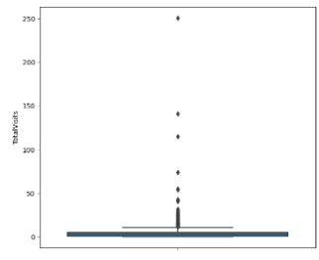
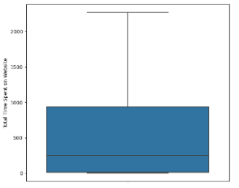
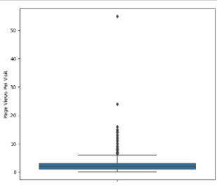
Numerical Variable Analysis :
Total Visits
Total Time Spent on Website
Page Views Per Visit

Slide 8
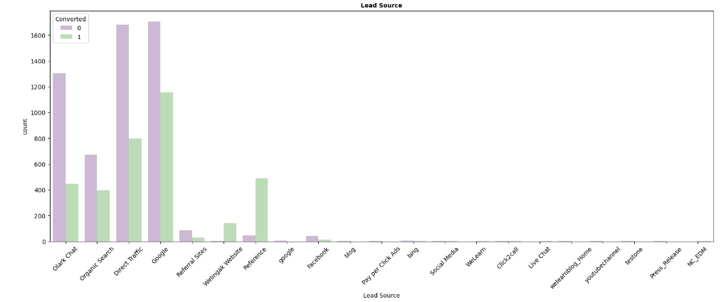
Lead Source
Inference : Google has the highest conversion rate

Slide 9
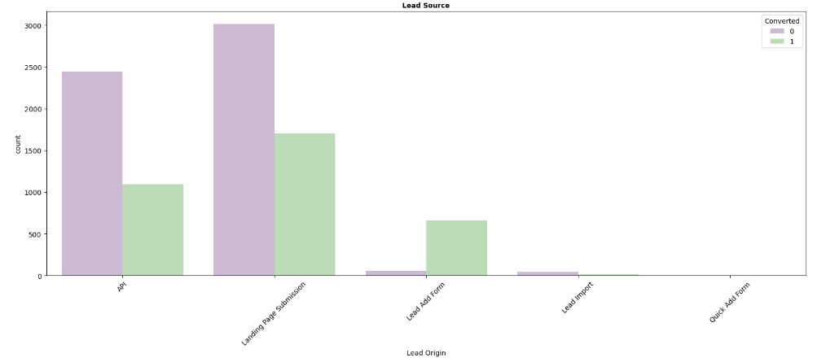
Lead Origin
Inference : Landing Page Submission has the highest conversion rate

Slide 10
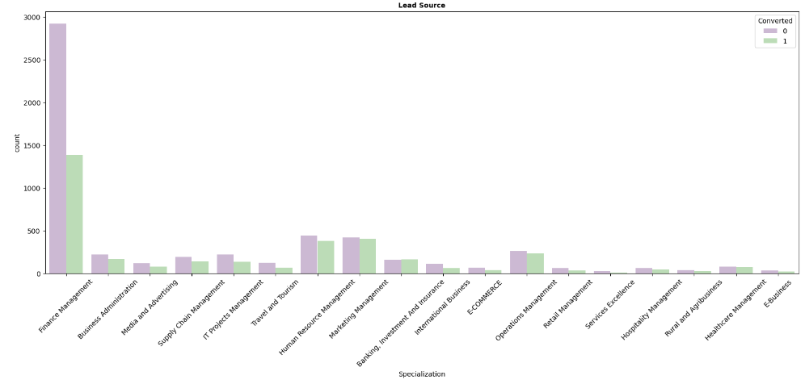
Specialization
Inference : Leads from Finance Management has the highest rate of conversion

Slide 11
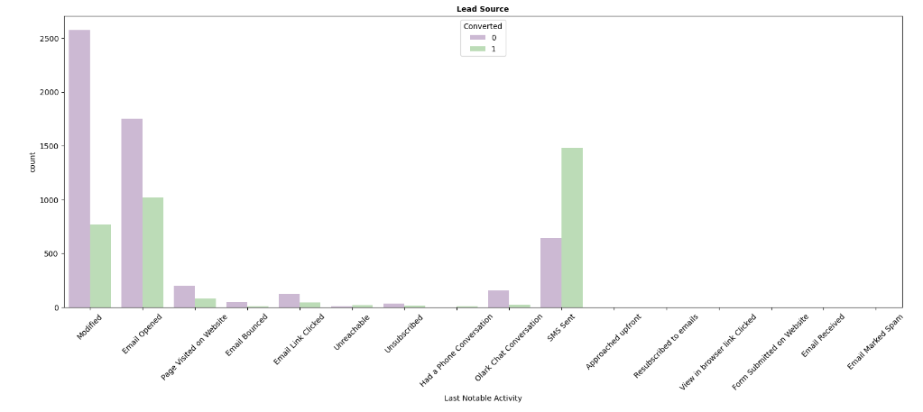
Last Notable Activity
Inference : Students with 'Last Notable Activity' as 'SMS sent' is with highest conversion rate

Slide 12
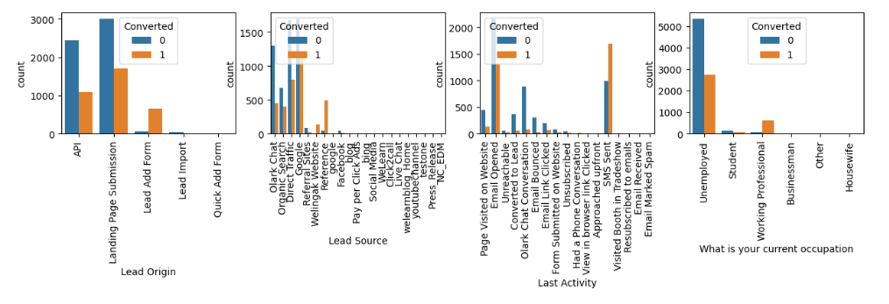
Categorical Column Analysis :
The majority of Converts are Professionals in the Workplace. Due to the job search and career aspects, people who are unemployed also have the highest conversion rates. The most leads are generated by "API" and "Landing Page Submission," although they have lower conversion rates. Less leads are generated through the "Lead Add Form," but the conversion rate is excellent.

Slide 13
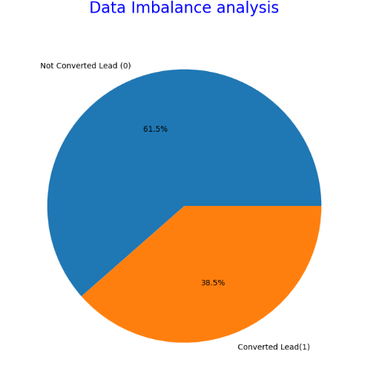
Data Imbalance Analysis :
As per the study above, the data is not overly unbalanced. In the data, 61.5% of leads are not converted, whereas 38.5% of leads are converted.

Slide 14
Model Building:
Dummy variables were created for categorical columns and scaling was done. In simpler words, we can say that the scaling is used for making data points generalized so that the distance between them will be lower. Scaling was carried out in order to bring all the features into a comparable range. Then we achieved the splitting of train and test dataset with 70% and 30%.
❖ Feature selection was applied using RFE technique and then the elimination was done according the steps followed for fetching the column having high p-value & VIF, a final model was obtained after occurrence of 4 times until both VIF and p-values reached under acceptable range.

Slide 15
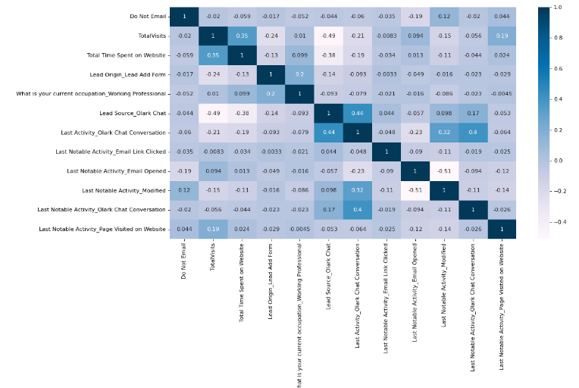
Correlation:

Slide 16
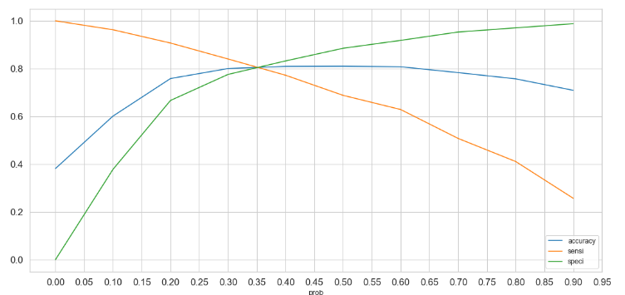
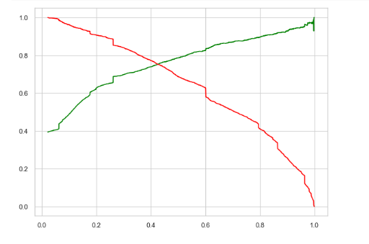
MODEL EVALUATION (TRAIN):
For Train Dataset
Accuracy: 80.99%
Sensitivity: 68.80%
Specificity: 88.51%
False positive rate - predicting the lead conversion when the lead does not convert: 0.1148
Precision/Positive predictive value: 78.70%
Negative predictive value: 82.14%
ROC : 0.95
F1 Score : 0.76

Slide 17
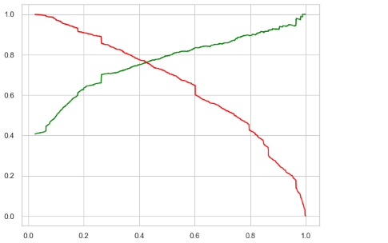
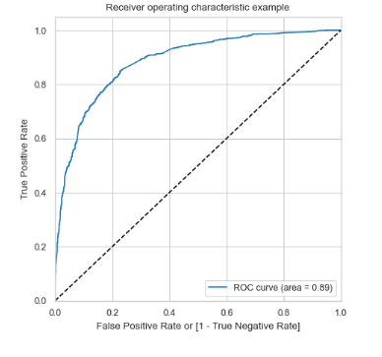
MODEL EVALUATION (TEST):
For Train Dataset
Accuracy: 80.36%
Sensitivity: 81.70%
Specificity: 79.48%
specificity: 79.48%
Precision - 0.7210264900662252
Recall - 0.8170731707317073
FP = 0.20511259890444308
TP = 0.7210264900662252
TN = 0.7210264900662252
ROC : 0.88

Slide 18
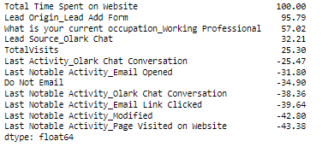
RELATIVE IMPORTANCE OF FEATURES:
Each feature's relative importance is calculated on a scale of 100, with 100 being the highest possible score.
• The model parameters' Coefficient (Beta) Values for each of these features are used to establish their relative relevance.
• Features with High Positive Beta Values are those that have a major impact on a lead's likelihood of conversion.
• In a similar vein, traits with high negative beta values make the least contribution. IMPORTANCE OF A FEATURE
• The top three factors that have the greatest effects on the likelihood of Lead Conversion

Slide 19
SITUATION 1: The company has two months of interns. They want to aggressively increase lead conversion. They want to call as many of these potential leads as they can since they want almost all of them to convert.
Solution: • The proportion of real conversions that were accurately predicted out of all actual conversions is known as sensitivity. As we previously observed, sensitivity declines as the threshold rises.
• High Sensitivity means that practically all leads who are likely to convert will be accurately predicted by our model. Additionally, some of the non-conversions can be overestimated and incorrectly categorised as conversions.
• It is a smart move to choose high sensitivity as the organisation has extra staff for two months and wants to increase the lead conversion's aggressiveness. We must select a LOW THRESHOLD VALUE in order to attain great sensitivity

Slide 20
SITUATION 2: The company occasionally meets its quarterly target ahead of schedule. It desires that the sales team concentrate on some fresh work. Therefore, the company's goal is to avoid making phone calls during this time unless they are really necessary.
Solution:
• The percentage of actual non-conversions that were accurately predicted out of all actual non-conversions is known as specificity. As the threshold rises, it rises as well.
• High Specificity means that practically all leads who are not likely to convert will be predicted correctly by our model. While doing so, it can mistakenly categories some conversions as non-conversions.
• High specificity is an excellent approach because the organization has already surpassed its quarterly goal and doesn't want to make pointless phone calls.
• It will make sure that only consumers with a very high chance of converting will receive phone calls. We must select a Great THRESHOLD VALUE in order to attain high specificity.

Slide 21
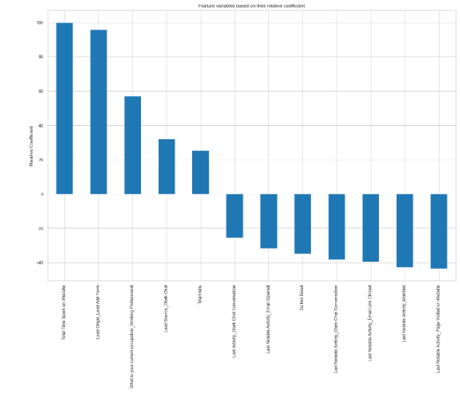
The top 3 factors that Most Influence the Chance of Lead Conversion
The top three categorical/ dummy variables on which the greatest attention should be paid in order to raise the likelihood of lead conversion are:
Who are hot leads potential paying customers to consider ?
1. Total Time Spent on Website 2. Lead Origin_Lead Add Form 3. What is your current occupation_Working Professional
Total Time Spent on Website
Lead Origin_Lead Add Form
What is your current occupation_Working Professional
Tag_ will revert after reading the email
• The "Working Professionals" should receive calls from the company because they are more likely to convert.
• Who frequently visits websites or who spends a lot of time on websites can be attracted by making websites more user-friendly and informative.
• You can target people based on their most recent SMS and email opening activity. • Individuals with the tag "Will revert after reading emails" may be potential targeted leads.
• Last Notable activity Had a phone conversation as the most recent noteworthy activity

Slide 22
Thank you

